Slide 1
Mobile sales Analysis
Dashboard in power bi

Slide 2
Project Summary:
Designed and implemented a mobile-optimized sales dashboard using Power BI to provide real-time, on-the-go visibility into sales performance for field sales reps and managers. The dashboard helped improve decision-making, productivity, and target tracking through a clean, responsive design and robust data insights.

Slide 3
Project Objectives:
Enable real-time access to key sales metrics from mobile devices
Help sales teams monitor performance against targets anytime, anywhere
Simplify complex data into an intuitive, mobile-friendly format
Empower regional managers to track and improve sales rep performance
Automate reporting and reduce manual data handling

Slide 4
Dashboard Features:
KPI Cards for Total Sales, Target Achievement %, YoY Growth
Bar & Line Charts to show trends and comparisons (sales by region, product, rep)
Pie Chart for product mix or market share
Geo Map to display sales by location
Drill-through Pages for individual sales rep or product performance
Mobile-First Layout designed using Power BI’s mobile layout view

Slide 5
DAX formula's
Create custom calendar for 4 years
= List. Dates(2021,1,1),1461,#duration(1,0,0,0)
Calculate Total quantity
Total Quantity = SUM(sales data[Units Sold])
Ccalculate Total Sales
Total Sales = SUMX(sales_data,sales_data[Units Sold]* sales data[Price Per Unit])
Calculate Total Transaction
Total Transaction : Transaction = COUNTROWS(sales data)
Calculate Average price
Average Price = AVERAGE(sales data[Price Per Unit])
Calculate Rating Status
Rating status= IF(sales data[Customer Ratings] >=4 , "Good",
IF(sales_data[Customer Ratings] >2 ,"average","poor"))
Calculation for MTD,QTD,YTD For cumulative calculated column
MTD = TOTALMTD(sales_data[Total_Sales],custom_calender[Date].[Date])
Same period last year = CALCULATE([Total_Sales],
SAMEPERIODLASTYEAR(custom_calender[Date].[Date])

Slide 6
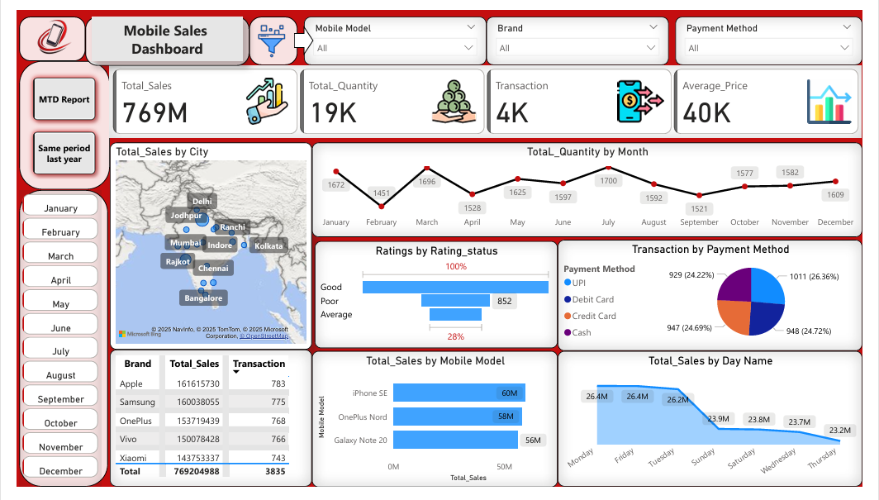

Slide 7
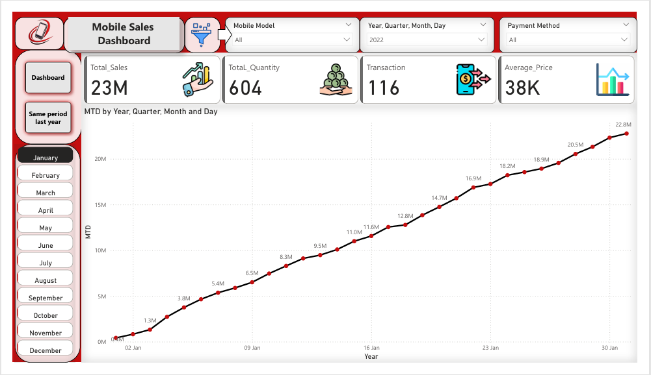

Slide 8
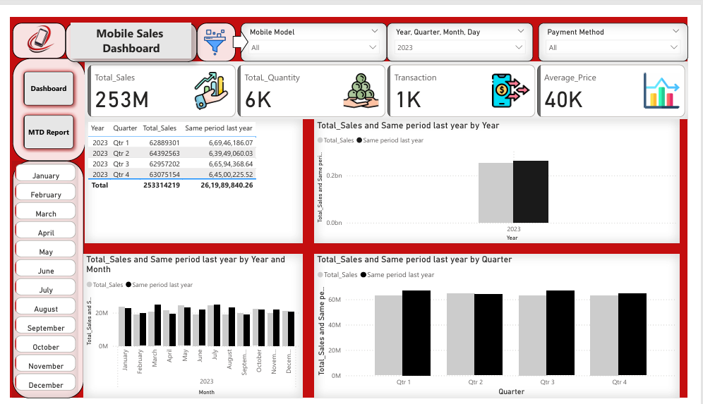

Slide 9
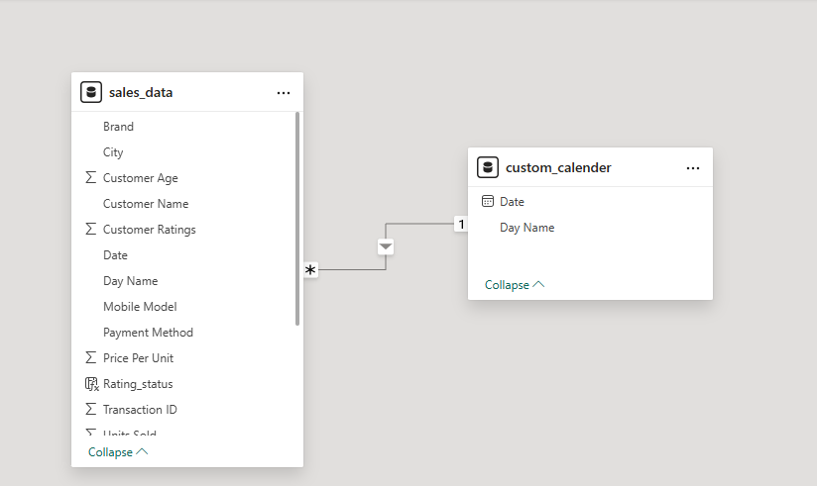
Data Model Creating Relationship

Slide 10
Conclusion
The Mobile Sales Dashboard project successfully delivered a dynamic and accessible reporting solution tailored for mobile users across the sales organization. By leveraging Power BI's mobile layout capabilities, the dashboard provided real-time, data-driven insights to field representatives and managers, enabling faster decision-making and greater responsiveness in the field.
Through seamless integration of multiple data sources, intuitive design, and secure role-based access, the solution not only enhanced sales visibility but also significantly reduced the reliance on manual reports. As a result, the project improved overall team efficiency, supported proactive sales management, and helped align daily activities with business goals.
The success of this project demonstrates the power of mobile BI in modern sales environments — offering flexibility, clarity, and performance tracking from any device, at any time.

